Slide 1
2020 09 07 YEAJIN KIM
Sales & Distribution Information
#Report Specification

Slide 2
Index
# Sales & Distribution Info
Technical
Logic
Technical
Description
How to
Validate
Information
Layout

Slide 3
Sales & Distribution
# Information
Report Name | Sales & Distibution Information | Sub Process | Sales Distribution
Purpose | 판매오더부터 배송.. Billing 까지 보기 위해 Open SO에 대해서 직접 Delivery 처리 업무도 가능
Definition | SD DOC 번호를 통한 관련 정보로 Delivery ( GI포함 ) 및 Billing 등의 SD 흐름 전반적인 정보를 가져 옴
Formula | Open SO Quantity = SO Quantity – Good Issue Quantity SO Processing Qty = Default : Open SO / Input-Mode를 통해 업무 진행 가능 SO Amount = SO Quantity * Net price
Frequency
Dimension | Characteristics : Sales Doc. No. , Item, Customer, Name, Material, Material Description, SO Q’ty, Open SO Q’ty, SO Processing Qty, Unit, Net Price, Currency, SO Amount, Delivery Doc., GI DOC, Year, Movement Type, GI Q’ty, GI Amount, Billing Doc. Billing Amount Key figures : SO Q’ty, Open SO Q’ty, Processing SO, SO Amount, GI Q’ty, GI Amount, Billing Amount
Comments | Sales Doc. No 클릭 시 , Sales Document 화면으로 이동. Customer 정보 더블클릭 시, Custom 정보 화면으로 이동. 자재 정보는 SAP Logon의 언어에 따라 다르게 적용. SO Processing Qty = 부족한 수량만큼 Input Mode로 원하는 수량을 입력한 뒤 GI 수행.
Data source | VA03
Plant | 1710
Issue No. |  | Contact person

Slide 4
Layout
Output
# Sales & Distribution Info
Input
24
25
26

Slide 5
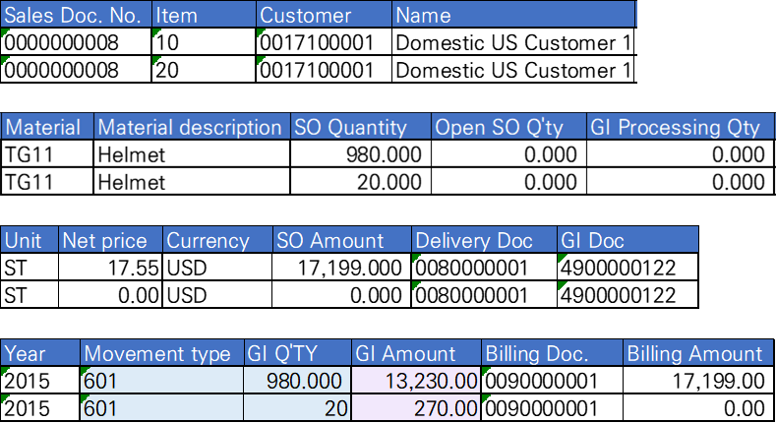
Layout
# Sales & Distribution Info
Output

Slide 6
Technical Logic
# Technical Logic For Definition
Source
Report
Transaction
Sales Order ( VA03 )
Table
VBAK ( Sales Doc. Header )
VBAP ( Sales Doc. Item )
MAKT ( Material Description )
LIPS ( Sales Doc. Delivery Item )
VBFA ( Doc. Flow )
MESG ( Doc. Segment : Material )
VBRP ( Billing Doc. : Item Data )
Transformation Rule
Condition

Slide 7
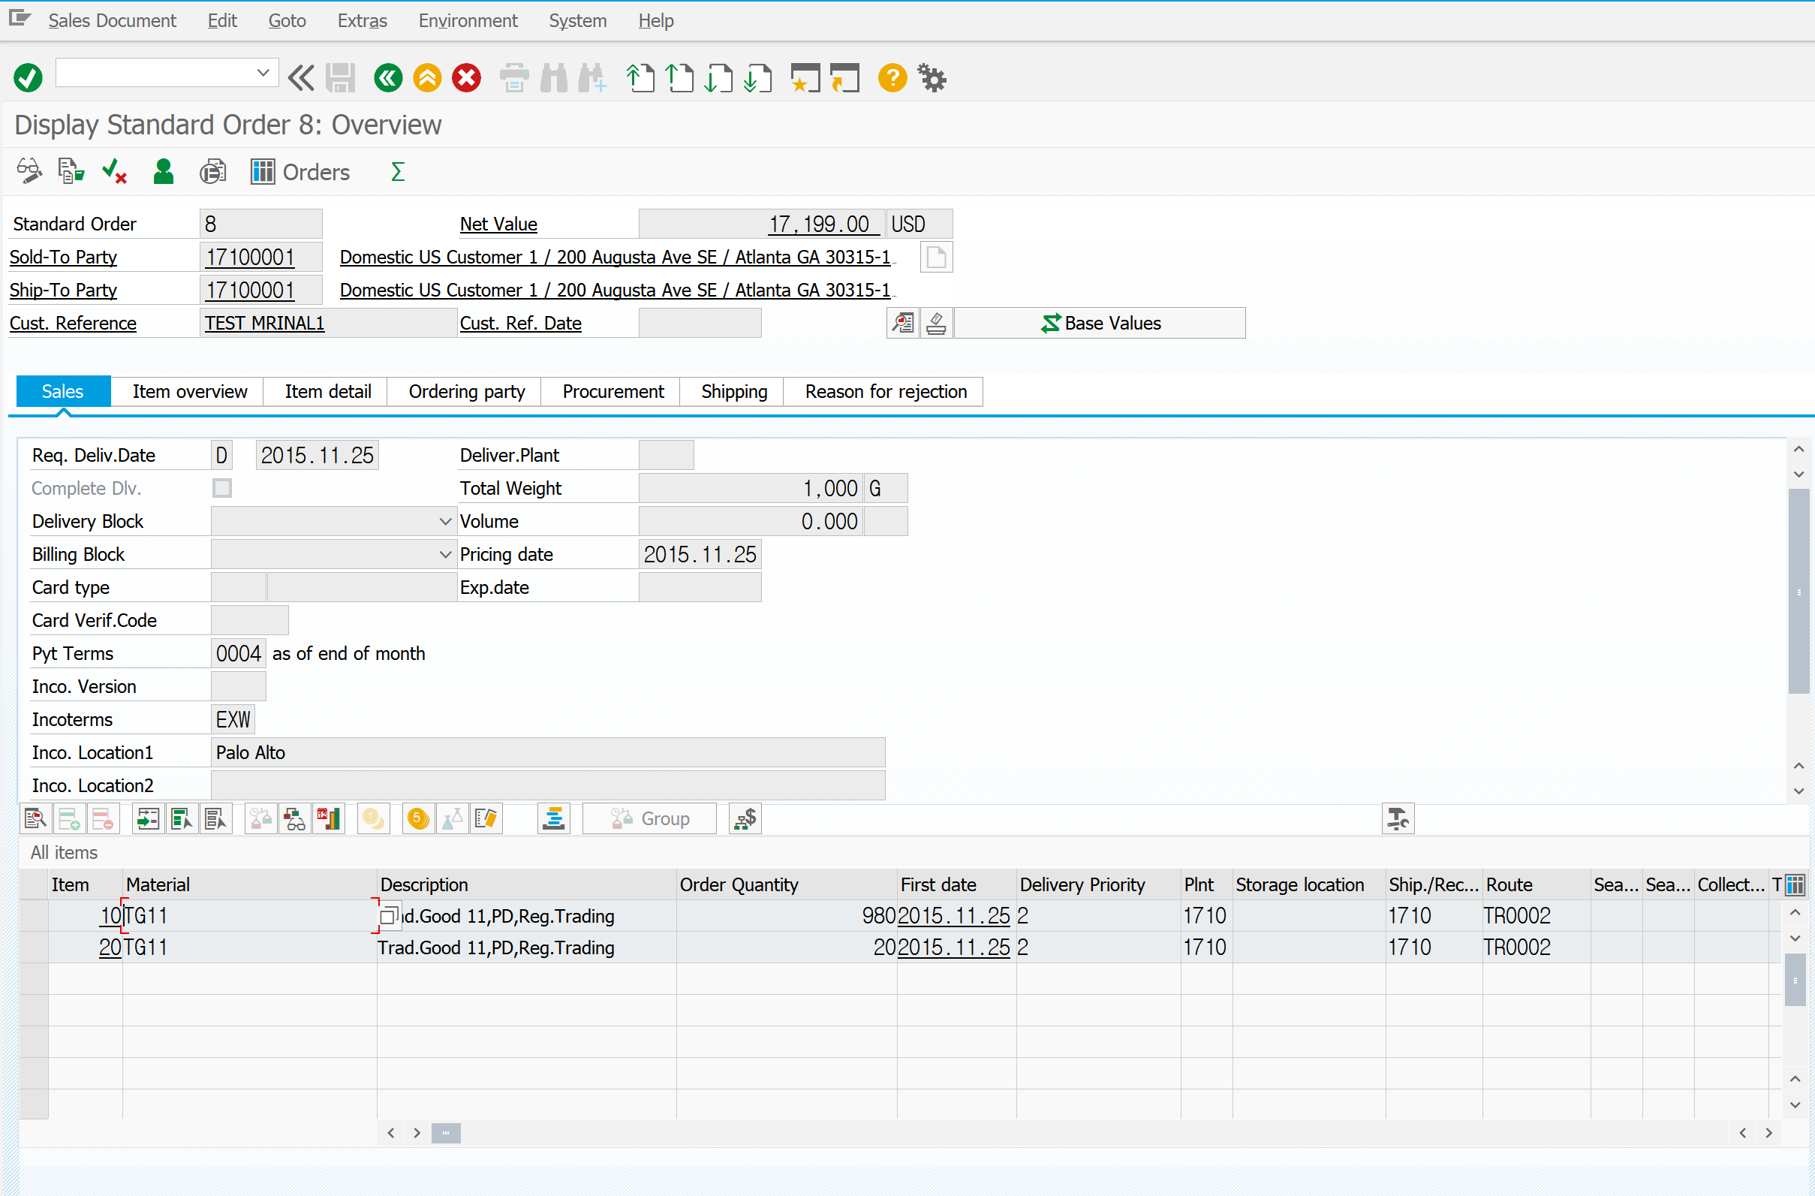
VA03 | Sales Order
Order Number | 8
Technical Description
# Overview
1
요청 날짜
2
ITEM : KEY

Slide 8
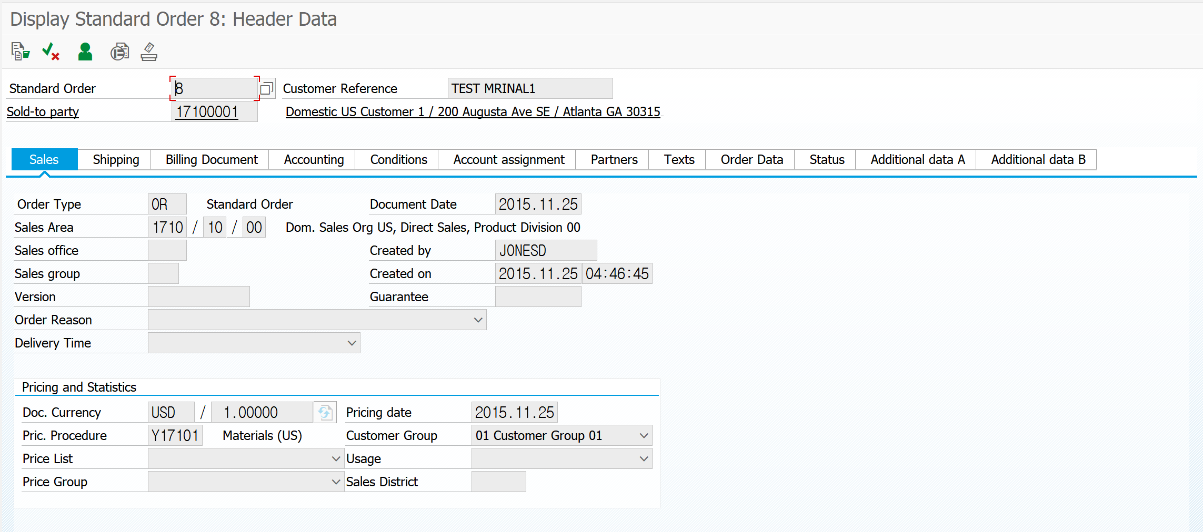
VA03 | Sales Order
Order Number | 8
Technical Description
# Header Data
3
4
24
25
26

Slide 9
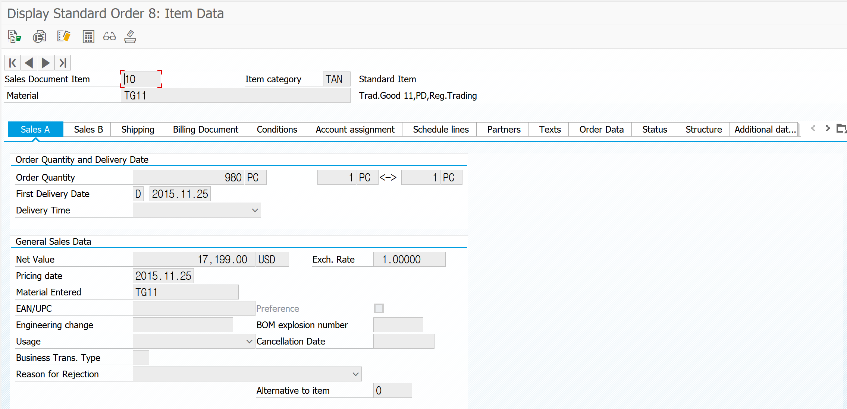
VA03 | Sales Order
Order Number | 8
Technical Description
# Item Data
5
9
12
13
14

Slide 10
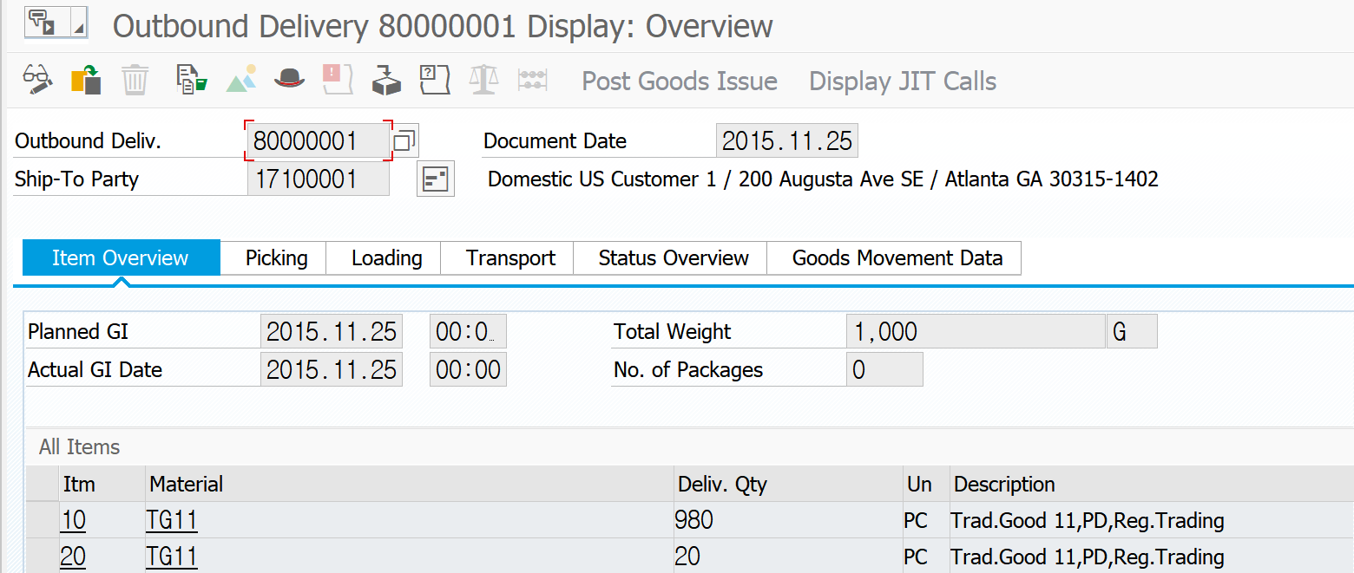
VA03 | Sales Order
Delivery Number | 0080000001
Technical Description
# Outbound Delivery
16

Slide 11
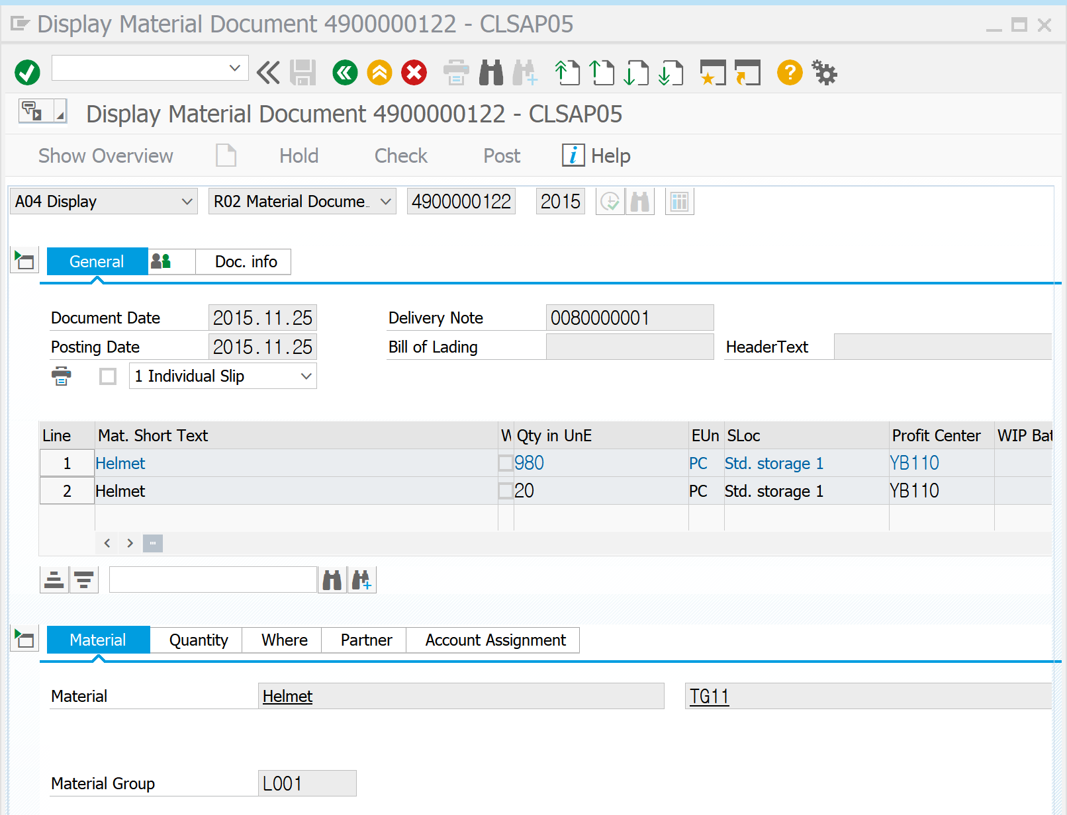
VA03 | Sales Order
Order Number | 8
Technical Description
# Good Issues
17
18
6

Slide 12
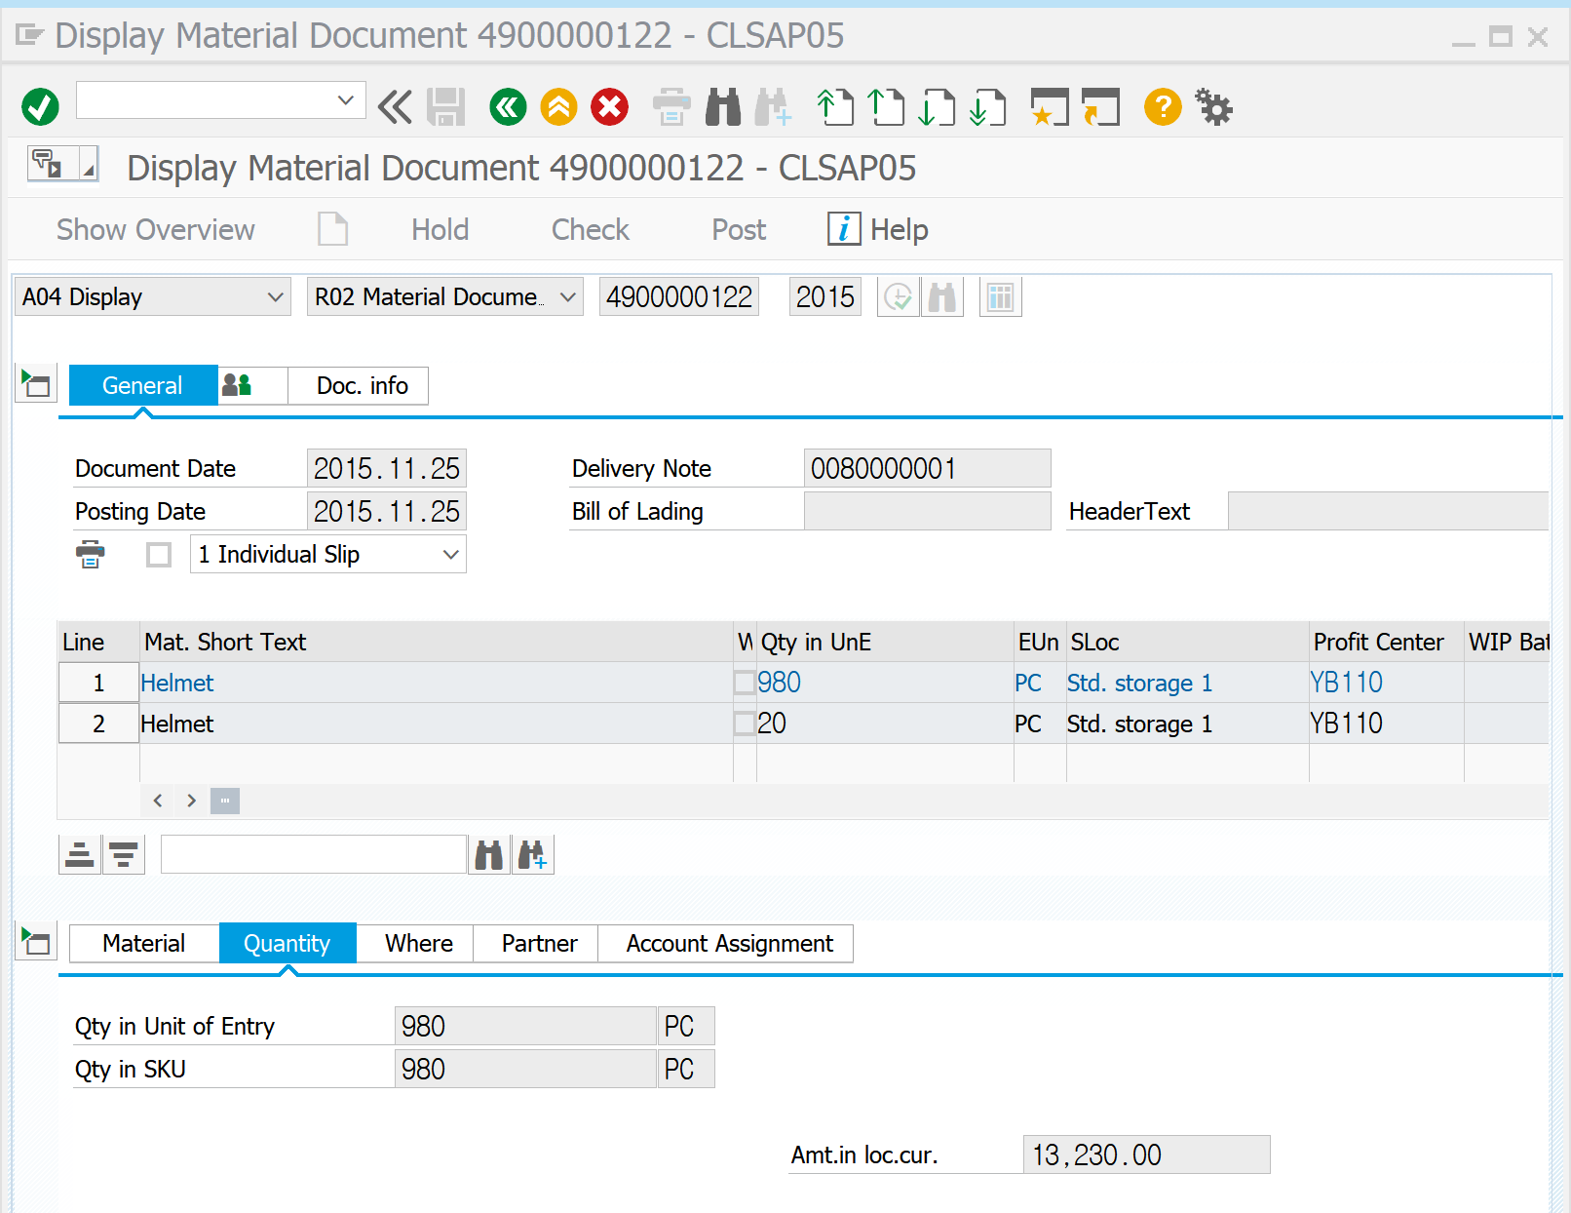
VA03 | Sales Order
Order Number | 8
Technical Description
# Good Issues
20
21

Slide 13
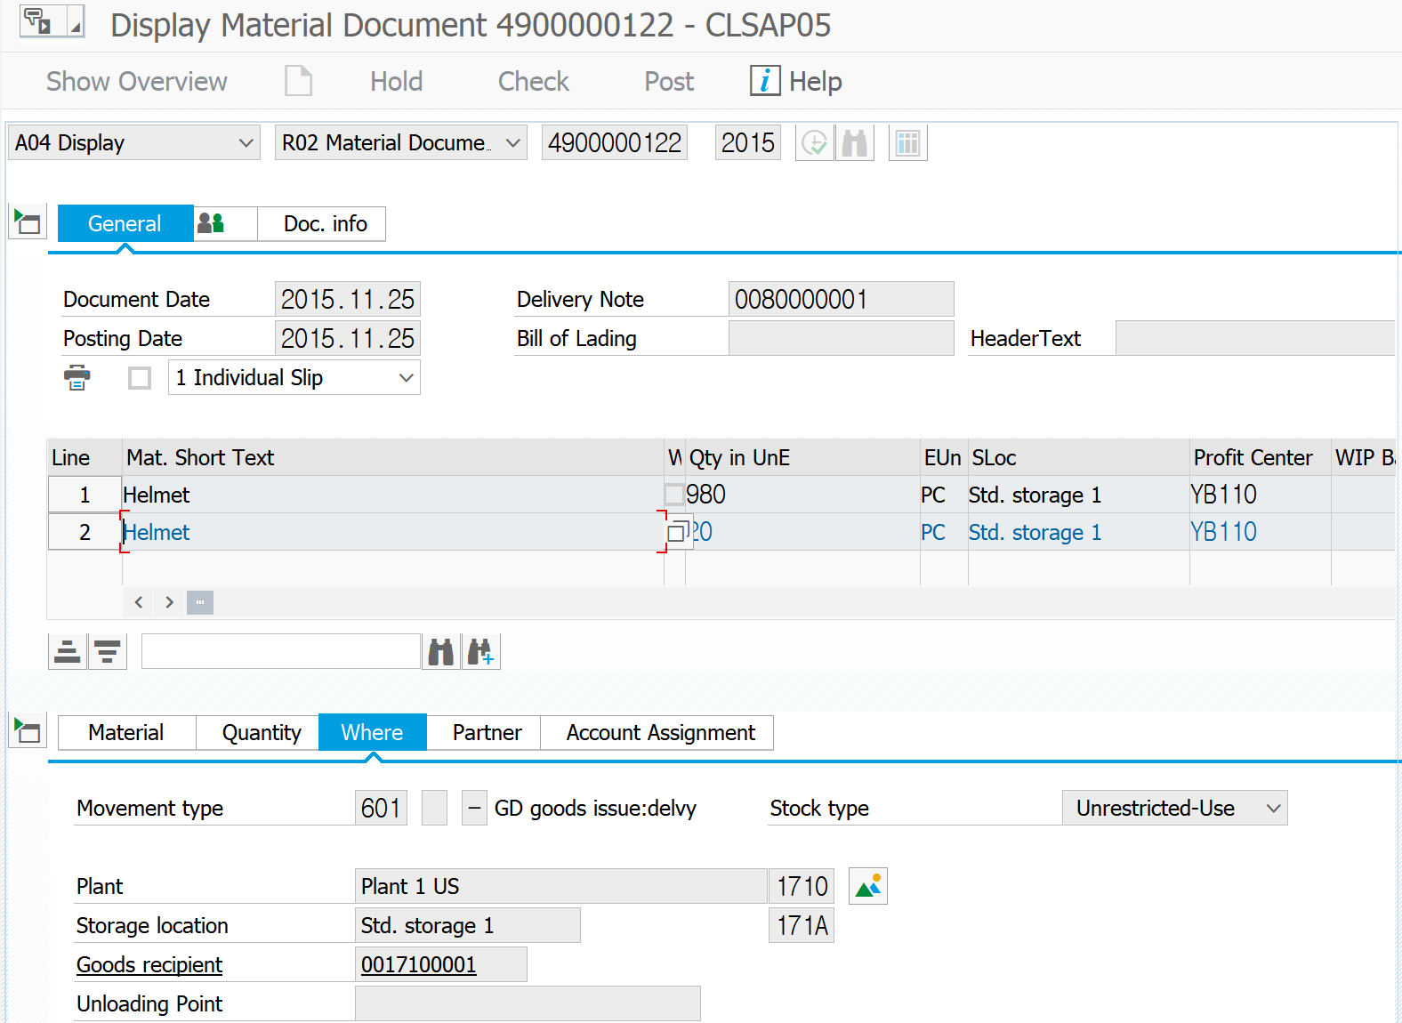
VA03 | Sales Order
Order Number | 8
Technical Description
# Good Issues
19

Slide 14
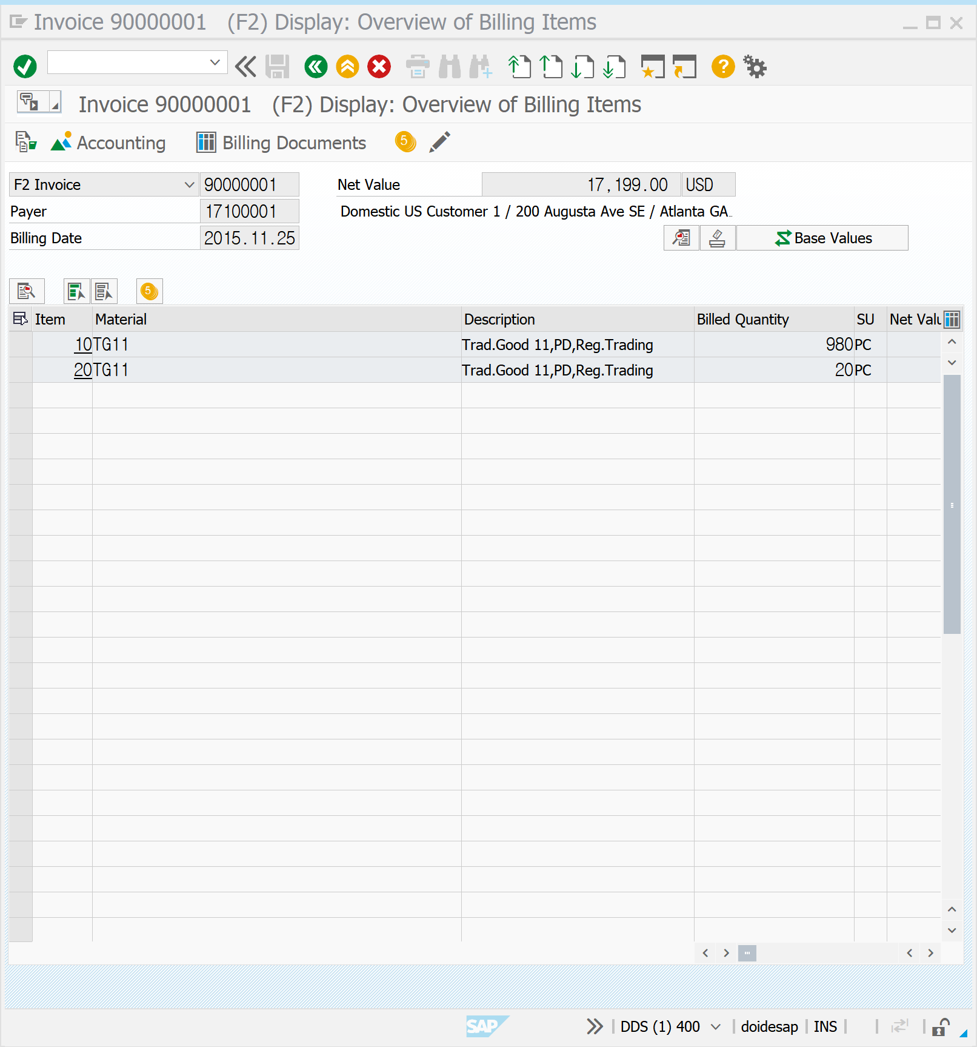
VA03 | Sales Order
Order Number | 8
Technical Description
# Invoice
22
23

Slide 15
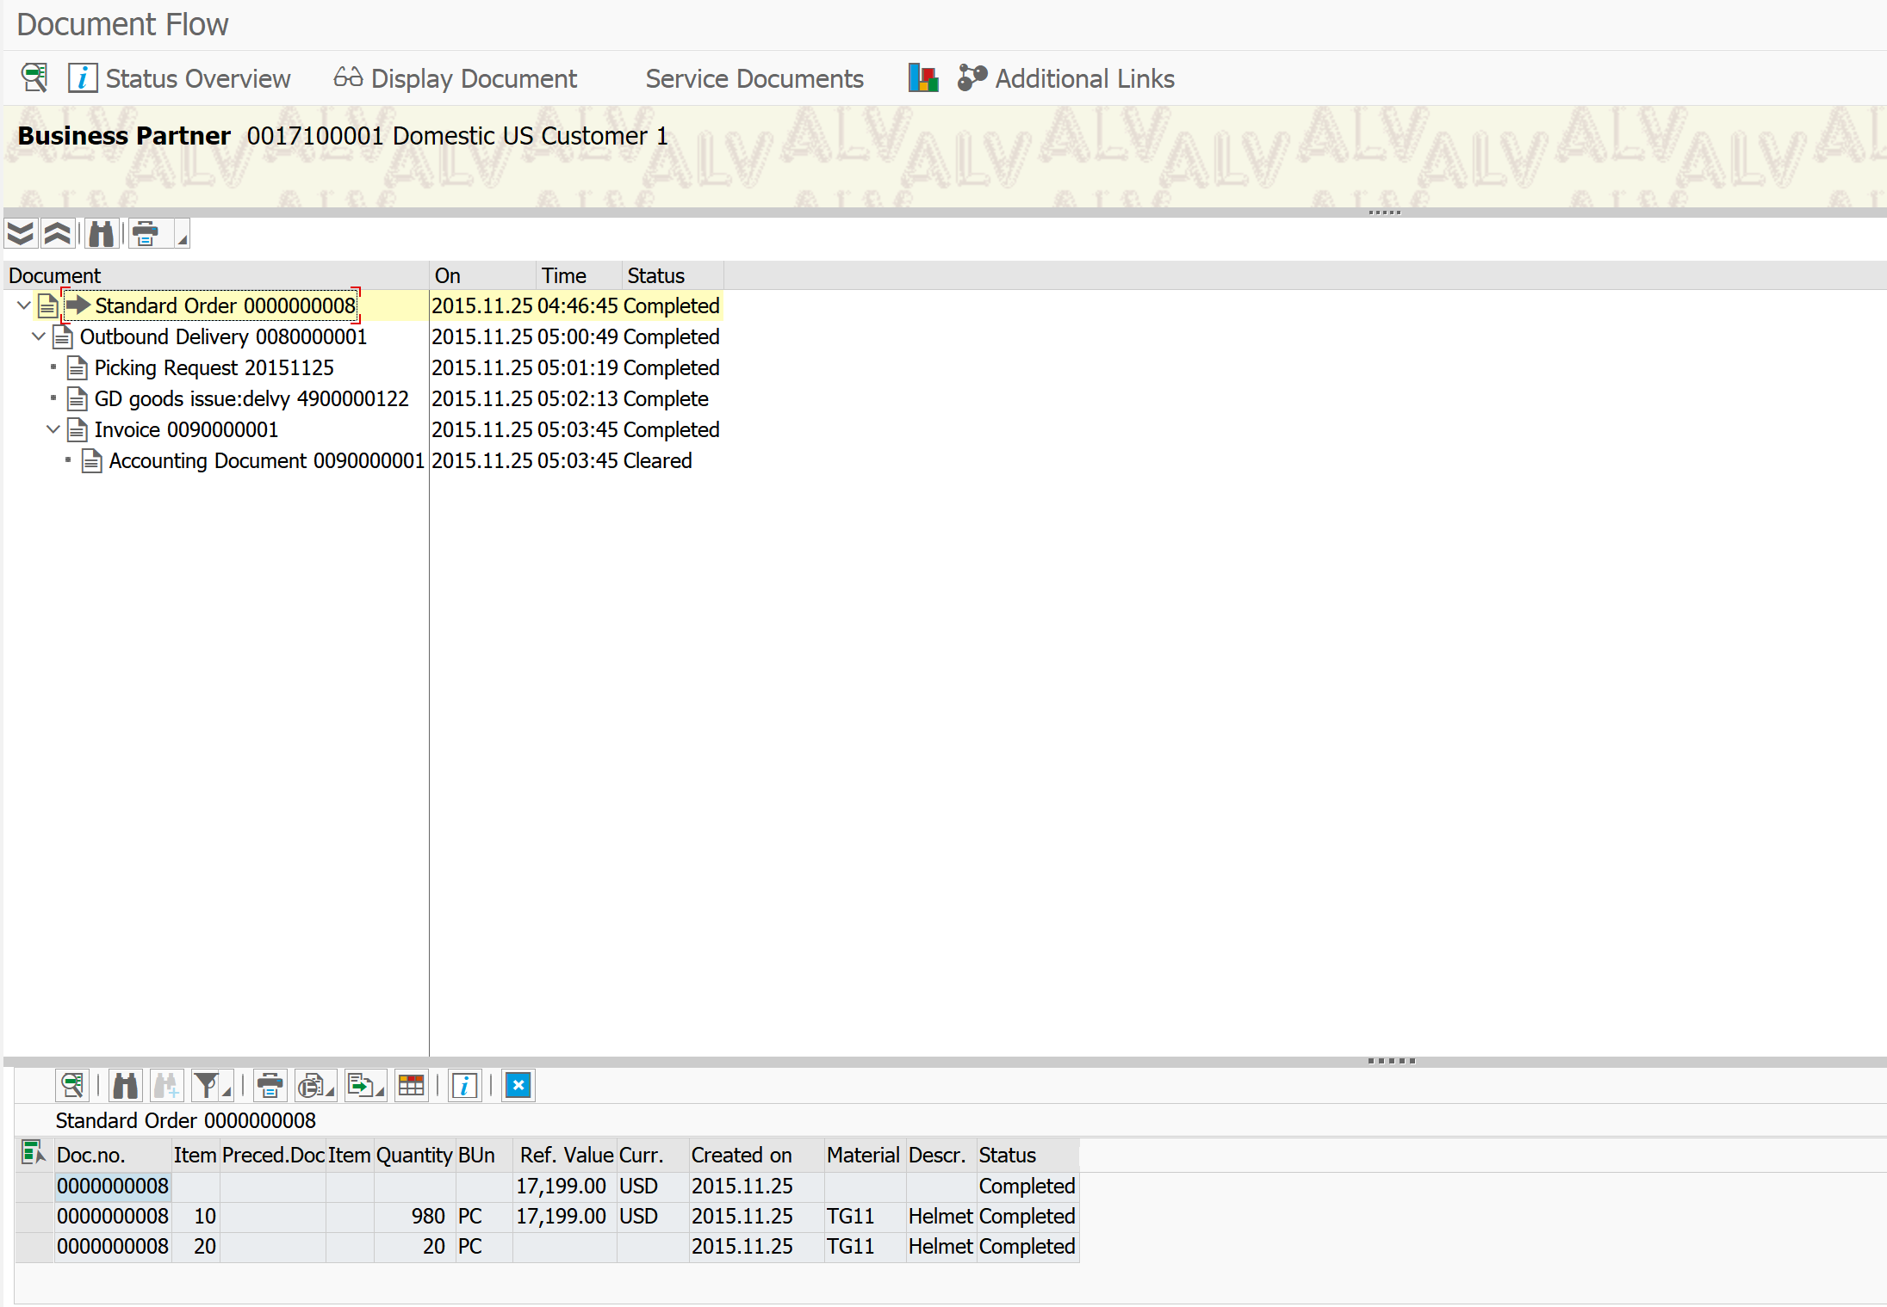
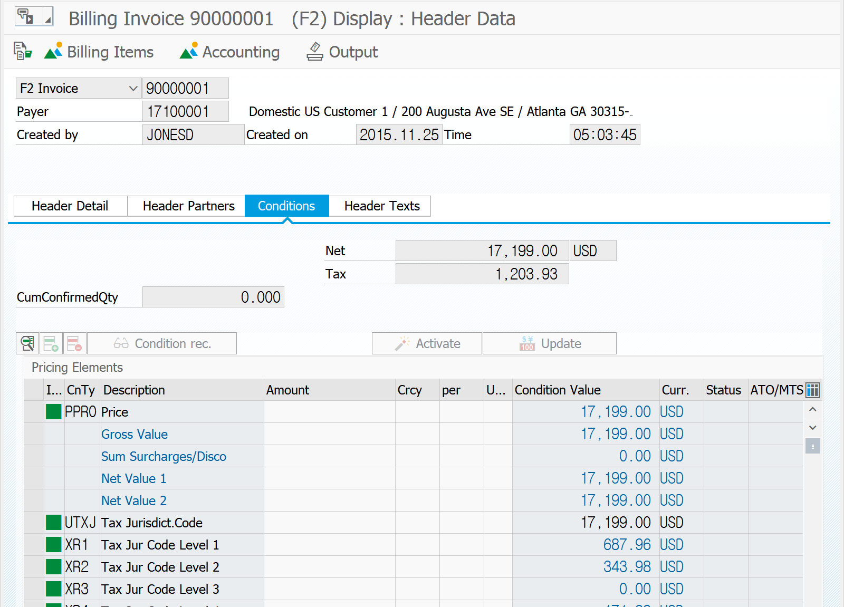
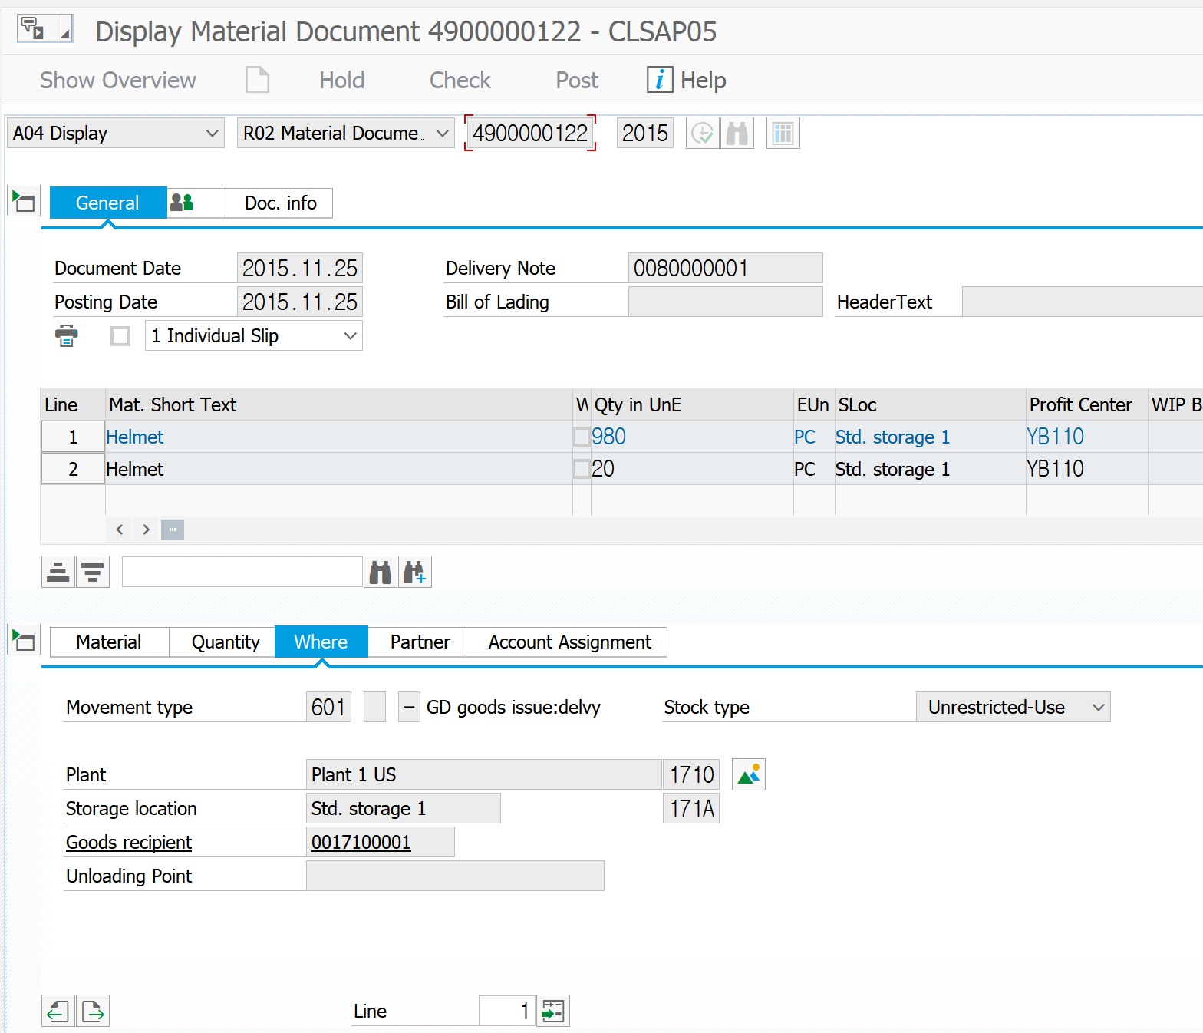
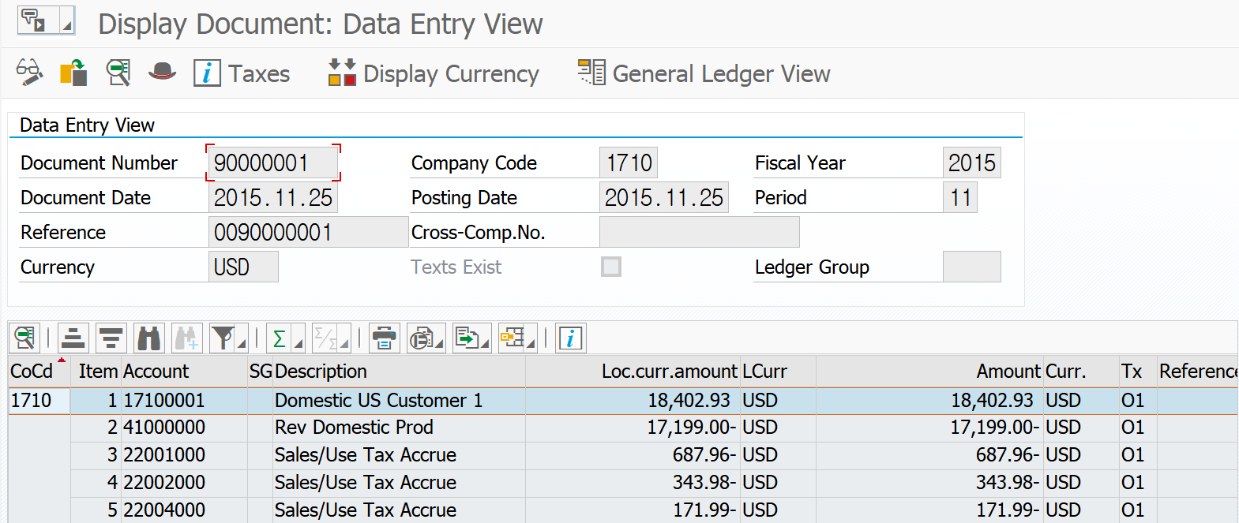
How to Validate_?
# Document Flow
DELIVERY DOCUMENT
MATERIAL DOCUMENT
BILLING DOCUMENT
FI DOCUMENT

Slide 16
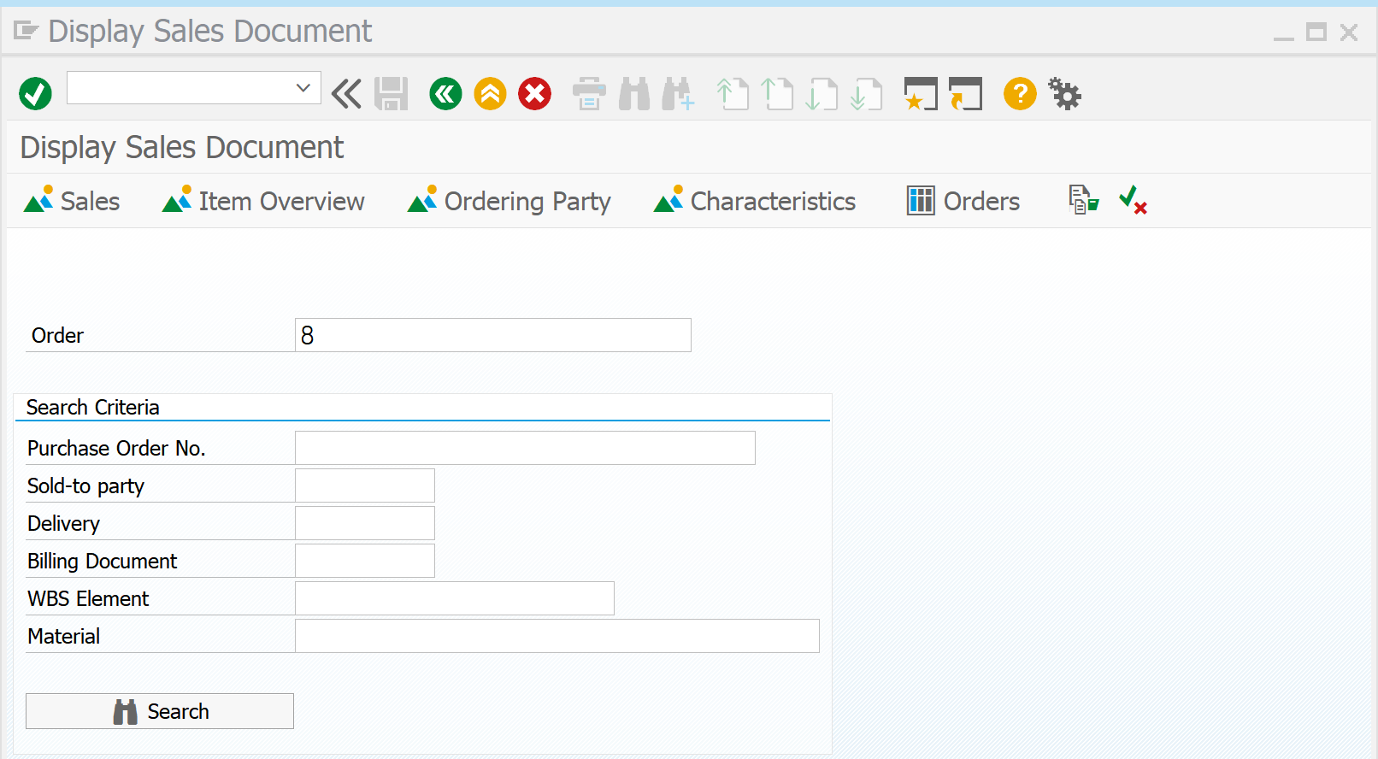
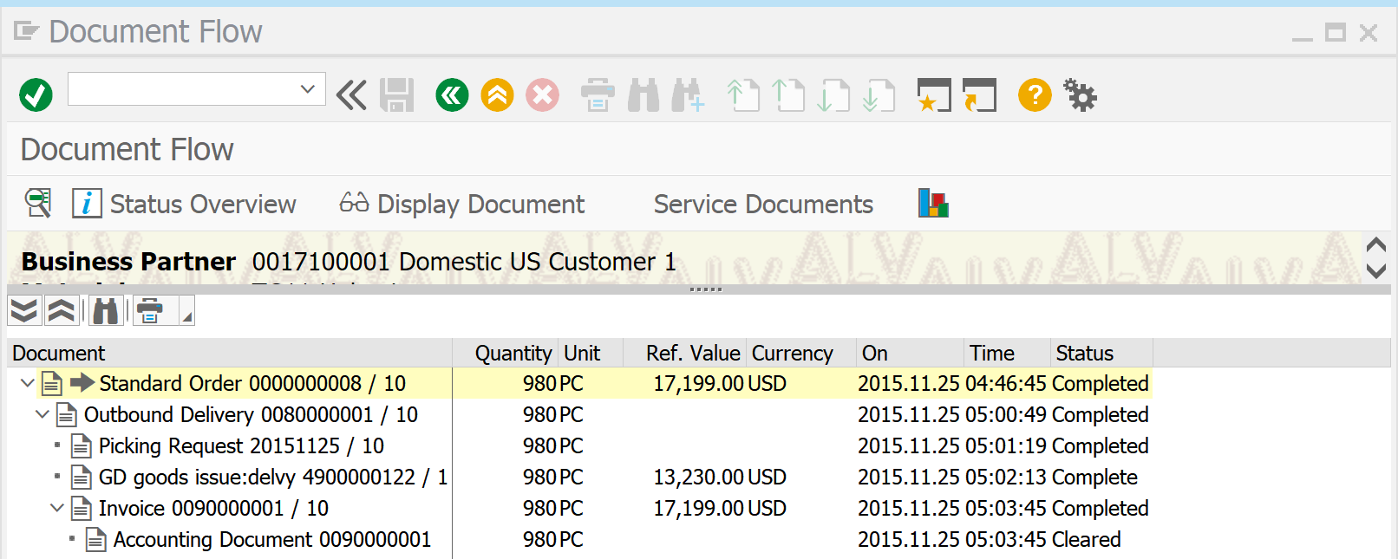
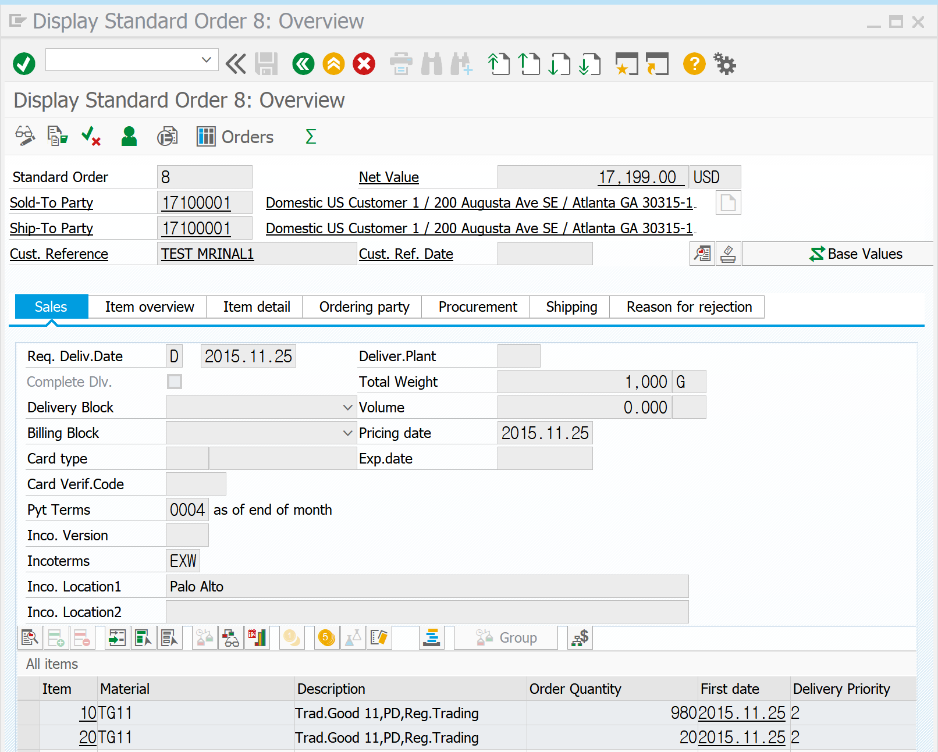
How to Validate_?
# Sales Order : Material Document
01. VA03 | SALES ORDER NUMBER ( 8 )

Slide 17
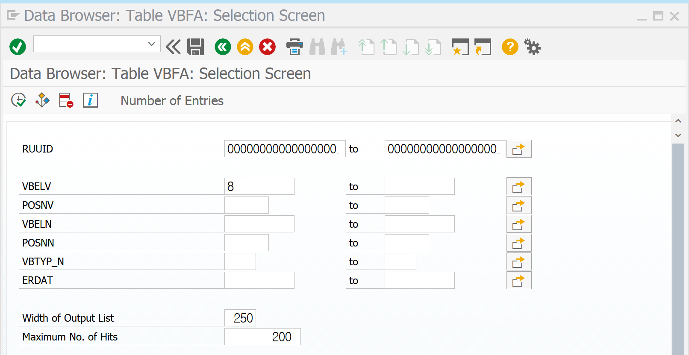
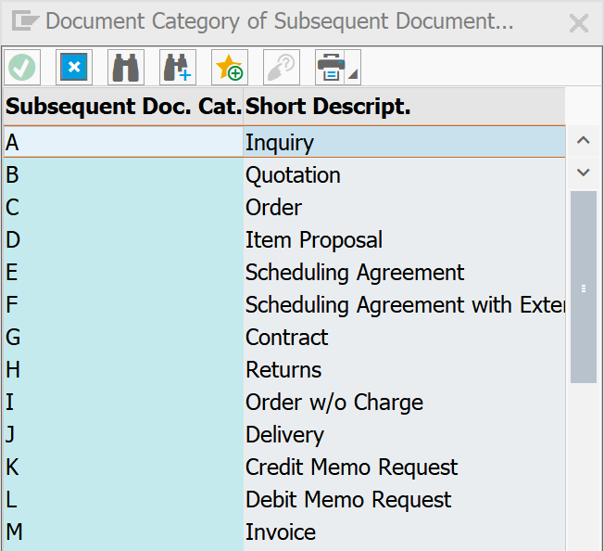
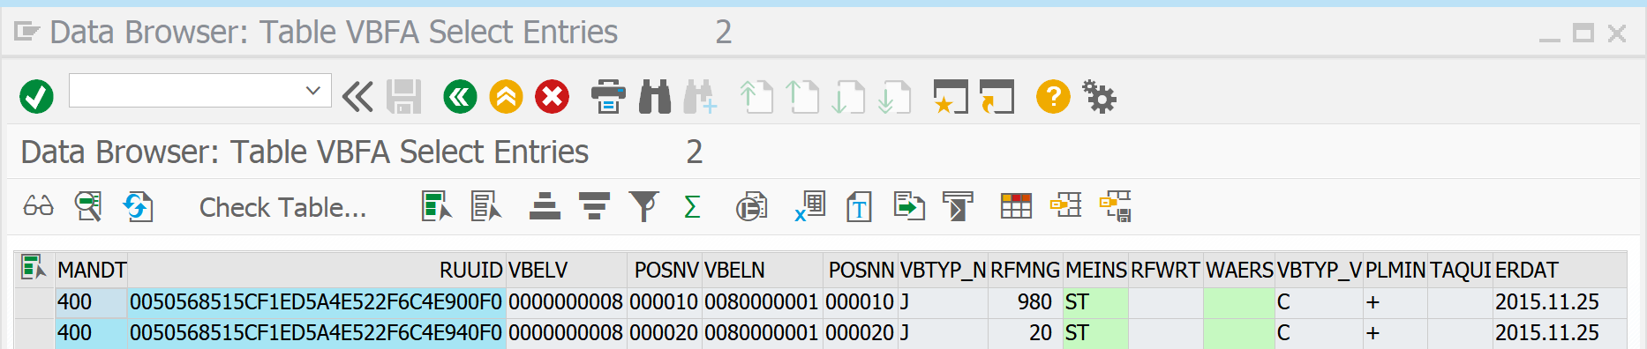
How to Validate_?
# Sales Order : Material Document
VBFA | SALES DOCUMENT FLOW
SALES ORDER NUMBER ( 8 ) 로 확인 할 수 있는 것 !
FOLLOWING DOC : 80000001
SUBSEQUENT DOC : DELIVERY ( J )
선행 문서필드에서
SALES ORDER NUMBER ( 8 )로
후속 문서 중 DELIVERY NUMBER를 찾음 |
DELIVERY ( J ) : NUMBER 8000001

Slide 18
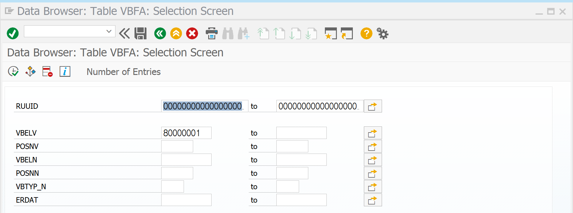
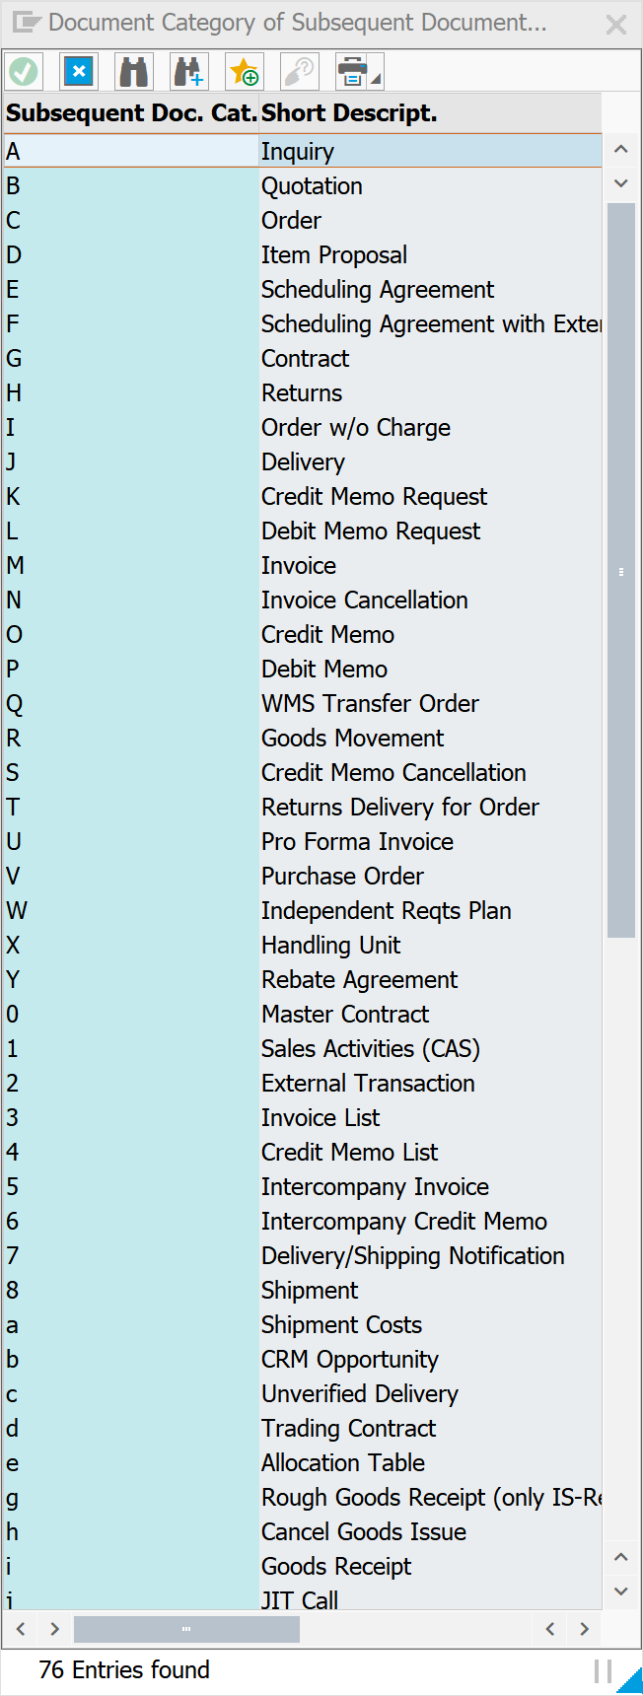
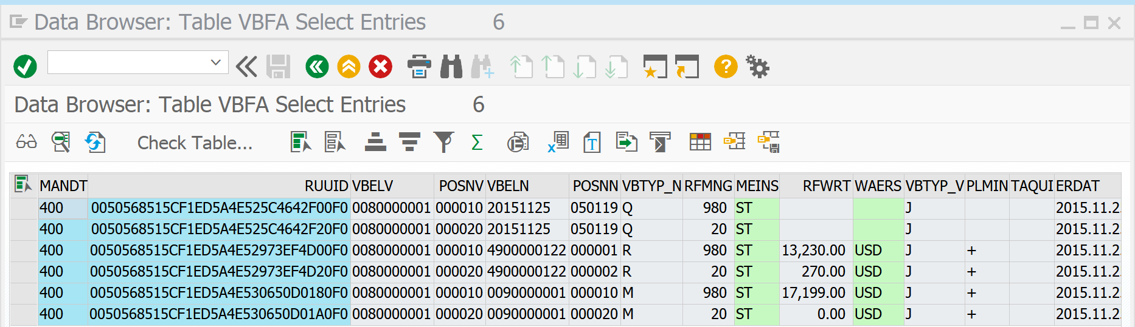

How to Validate_?
# Sales Order : Material Document
선행문서 필드에
위에서 찾은 DELIVERY NUMBER를 넣어
후속 문서 중
MATERIAL DOCUMENT( R )를 찾음 : 4900000122

Slide 19
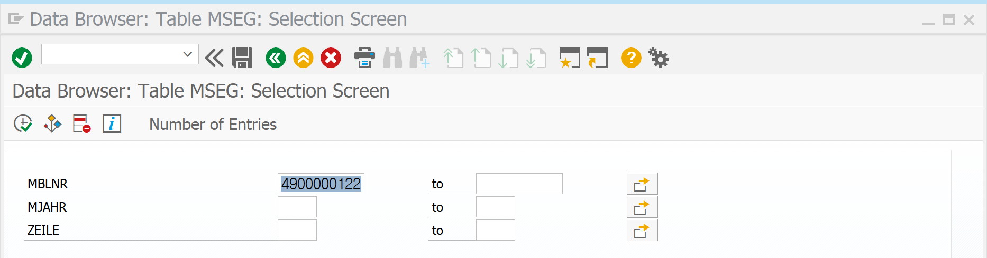
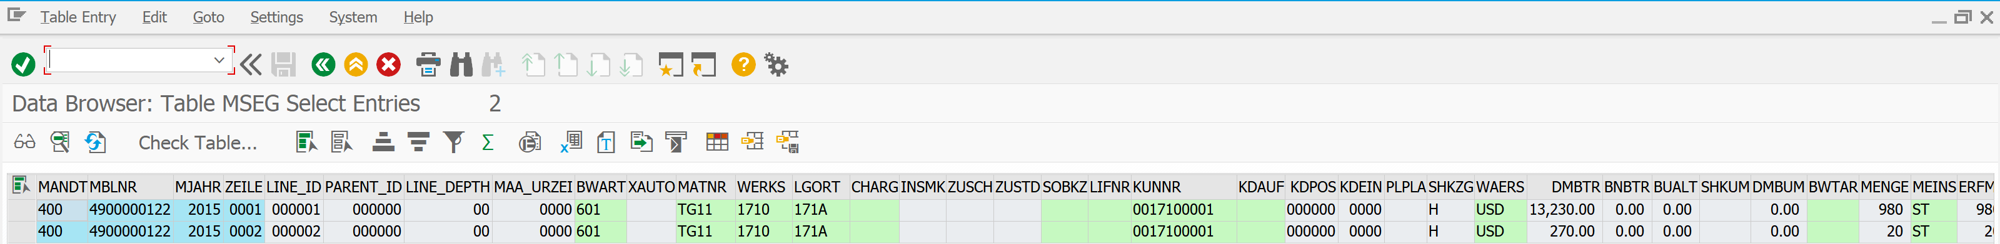
How to Validate_?
# Sales Order : Material Document
MSEG | 위에서 찾은 MATERIAL DOCUMENT ,
ITEM ( 1, 2 ) , YEAR( 2015 )로 수량 및 금액 계산

Slide 20
How to Validate_?
# Sales Order : Billing Document
VBFA | SALES DOCUMENT FLOW
SALES ORDER NUMBER ( 8 ) 로 확인 할 수 있는 것 !
FOLLOWING DOC : 80000001
SUBSEQUENT DOC : DELIVERY ( J )
선행 문서필드에서
SALES ORDER NUMBER ( 8 )로
후속 문서 중 DELIVERY NUMBER를 찾음 |
DELIVERY ( J ) : NUMBER 8000001

Slide 21
How to Validate_?
# Sales Order : Billing Document
선행문서 필드에
위에서 찾은 DELIVERY NUMBER를 넣어
후속 문서 중 INVOICE DOCUMENT를 찾음
: BILLING DOCUMENT ( M )

Slide 22
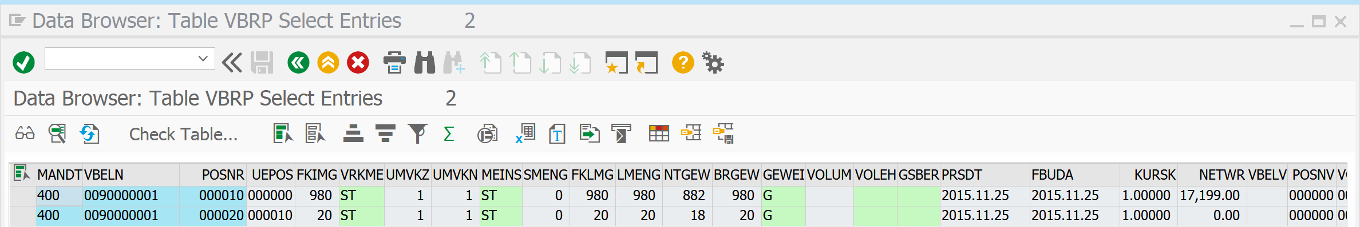
How to Validate_?
# Sales Order : Billing Document
VBRP | 위에서 찾은 INVOICE NUMBER와
ITEM NUMBER로 수량 및 금액을 찾음

